Slide 1
Chemistry Registry System for OpenPHACTS
Valery Tkachenko
Royal Society of Chemistry

Slide 2

50 million chemicals and growing
Data sourced from >500 different sources
Crowdsourced curation and annotation
Ongoing deposition of data from our journals and our collaborators
A structure centric hub for web-searching

Slide 3
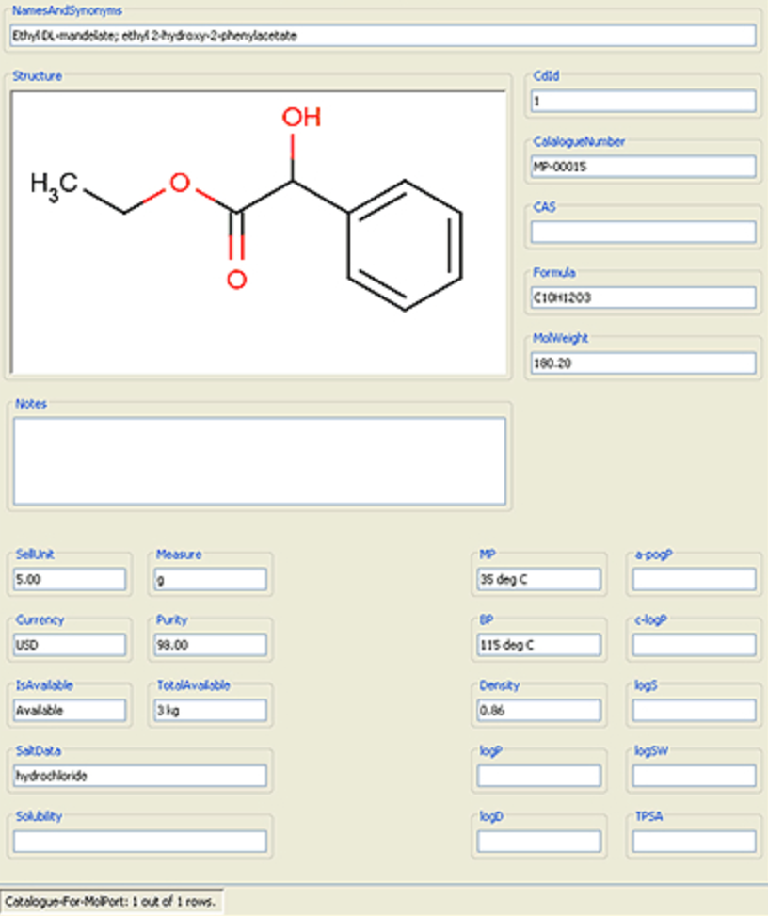
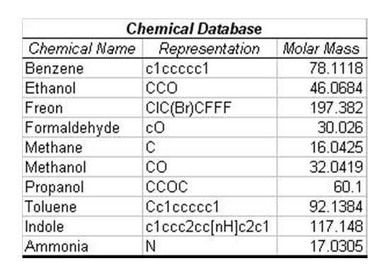
Chemical database

Slide 4
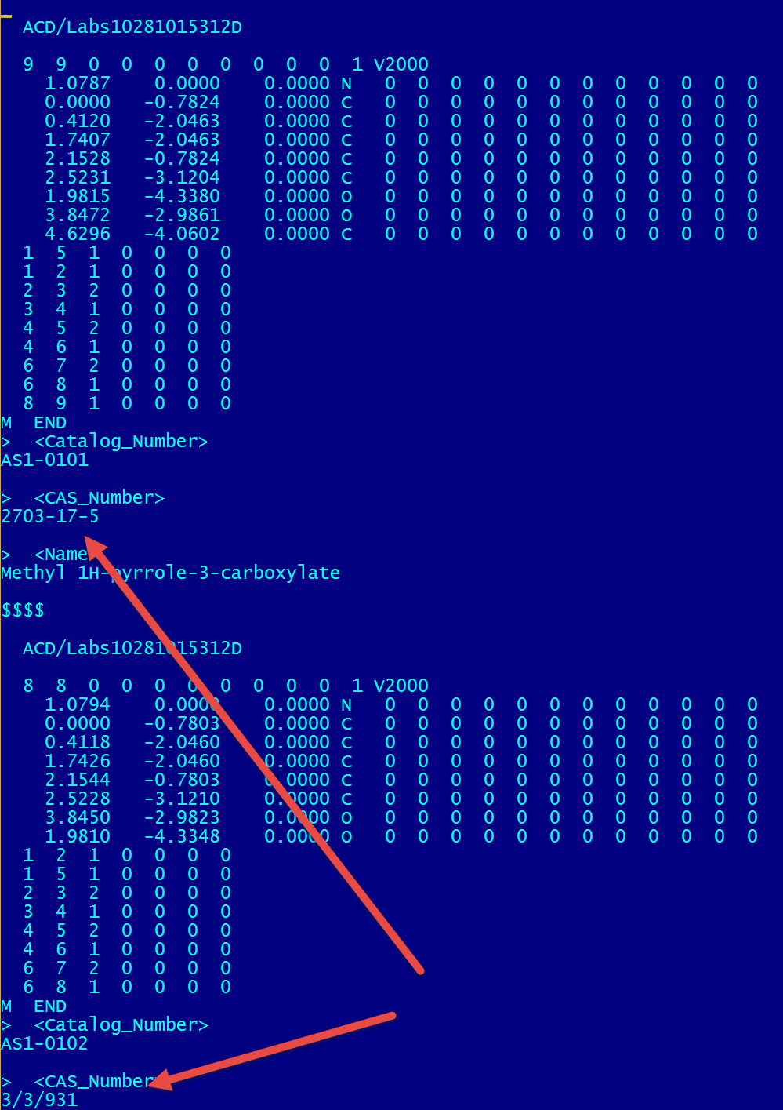

Slide 5
Data quality issues
Robochemistry
Proliferation of errors in public and private databases
Automated quality control system

Slide 6
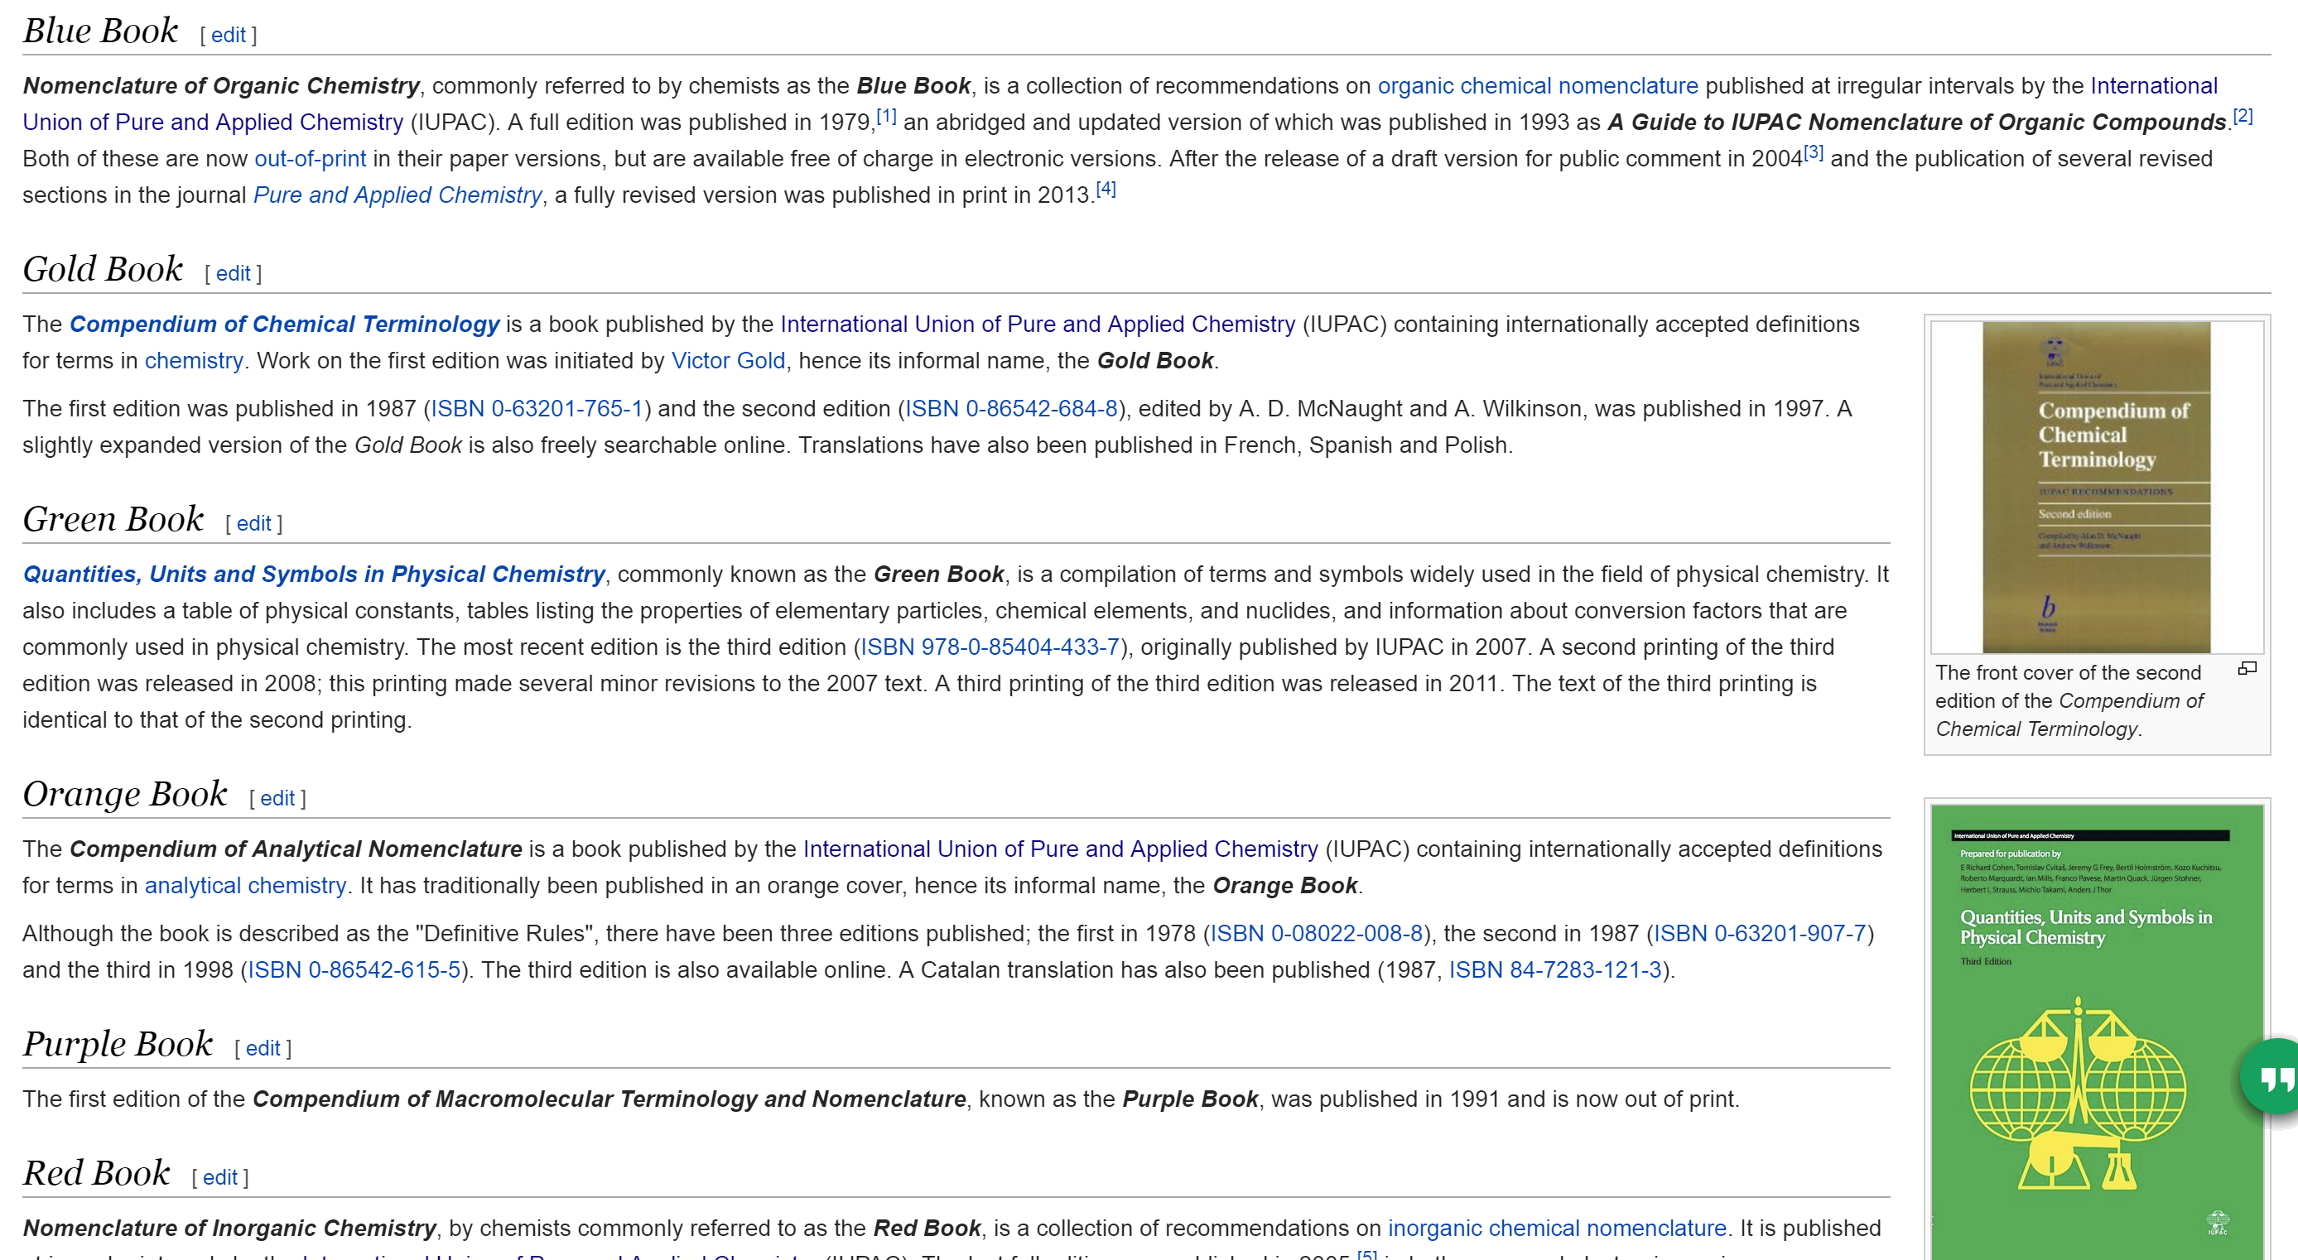
Standards?

Slide 7
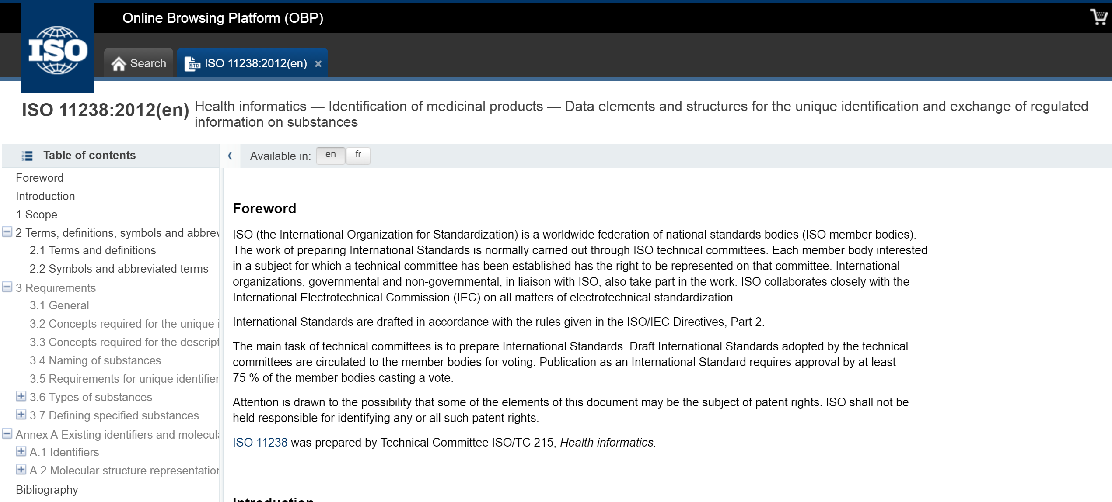
Standards?

Slide 8
SPL Substance Index Files
-FDASRS-04291423352D
21 22 0 0 0 0 0 0 0 0999 V2000
2.3000 -2.8000 0.0000 N 0 0 0 0 0 0 0 0 0 0 0 0
3.4417 -2.1375 0.0000 C 0 0 0 0 0 0 0 0 0 0 0 0
4.6000 -2.8000 0.0000 C 0 0 0 0 0 0 0 0 0 0 0 0
2.3000 -4.1292 0.0000 C 0 0 0 0 0 0 0 0 0 0 0 0
9.1875 -4.1292 0.0000 C 0 0 0 0 0 0 0 0 0 0 0 0
9.1875 -2.8000 0.0000 C 0 0 0 0 0 0 0 0 0 0 0 0
8.0417 -4.7917 0.0000 C 0 0 0 0 0 0 0 0 0 0 0 0
3.4417 -4.7917 0.0000 N 0 0 0 0 0 0 0 0 0 0 0 0
6.8875 -2.8000 0.0000 C 0 0 0 0 0 0 0 0 0 0 0 0
5.7417 -2.1375 0.0000 C 0 0 0 0 0 0 0 0 0 0 0 0
4.6000 -4.1292 0.0000 C 0 0 0 0 0 0 0 0 0 0 0 0
8.0417 -2.1375 0.0000 C 0 0 0 0 0 0 0 0 0 0 0 0
6.8875 -4.1292 0.0000 C 0 0 0 0 0 0 0 0 0 0 0 0
3.4417 -0.8125 0.0000 N 0 0 0 0 0 0 0 0 0 0 0 0
Chemical substance
UNII: AN164J8Y0X
Chemical structure (MOLFILE)
InChI=1S/C14H18N4O3/c1-19-10-5-8(6-11(20-2)12(10)21-3)4-9-7-17-14(16)18-13(9)15/h5-7H,4H2,1-3H3,(H4,15,16,17,18)
IEDVJHCEMCRBQM-UHFFFAOYSA-N
Biological substance (plant)
UNII: 1KE45XD28S
Bibliographic reference: Cichorium intybus L.

Slide 9
Input pipeline
Notes:
Change to add more database, rearrange

Slide 10
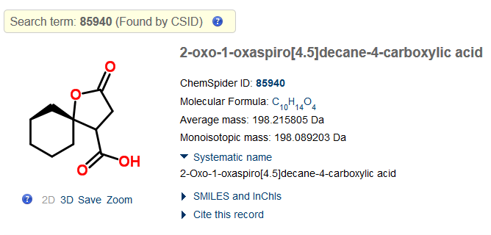
ChemSpider issues

Slide 11
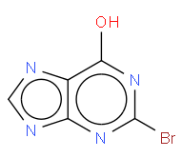
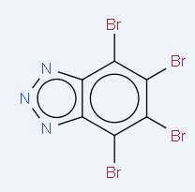
DrugBank dataset (6516 records)
~60 records that can’t be dearomatized unambiguously
DB04283
DB04462

Slide 12
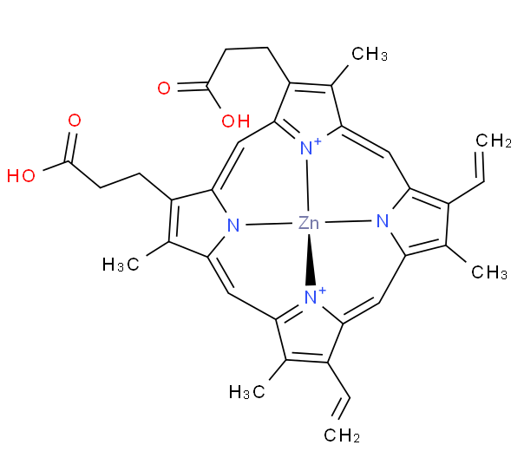
DB04283
DDB04009

Slide 13
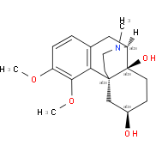
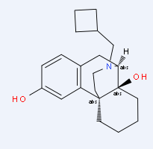
2 records where Smiles, InChI, and name did not match the structure
DB00611
DB01547

Slide 14
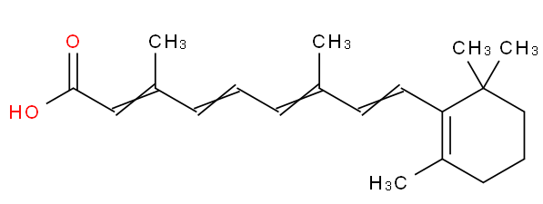
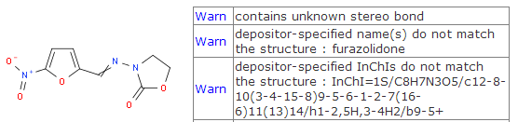
~40 records where InChIs did not match the structure
DrugBank ID: DB00755
InChI=1S/C20H28O2/c1-15(8-6-9-16(2)14-19(21)22)11-12-18-17(3)10-7-13-20(18,4)5/h6,8-9,11-12,14H,7,10,13H2,1-5H3,(H,21,22)/b9-6+,12-11+,15-8+,16-14+
DruGBank ID: DB00614

Slide 15
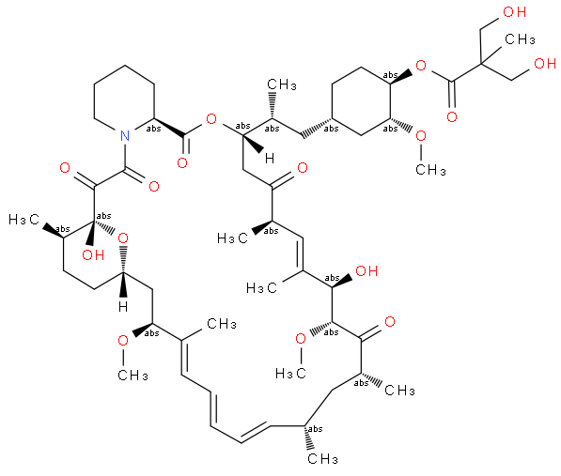
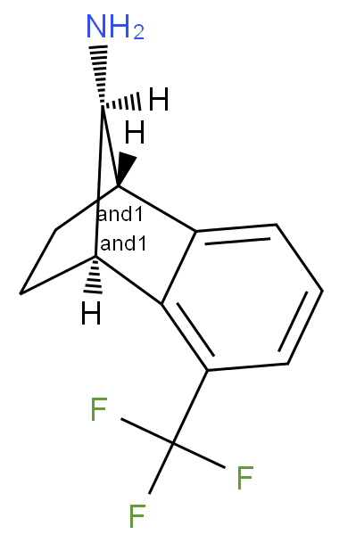
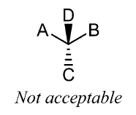
7 records with 2 stereo bonds at chiral atoms
J. Brechner, IUPAC
Graphical Representation of stereochem. configurations
Section: ST-1.1.10
DB08128
DB06287

Slide 16
CVSP validation of ChEMBL 16 (~1.3 mln. records)
Overall 0.7% of records had validation issues
Stereo problems (~82%)
Directions of bonds do not make sense (~63%)
Ambiguous stereo : 2 stereo bonds at chiral center (~19%)

Slide 17
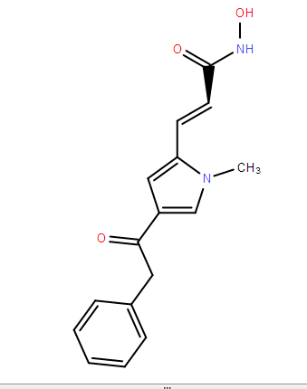
“Direction of bond makes no sense” – 63%

Slide 18
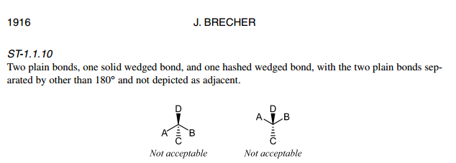
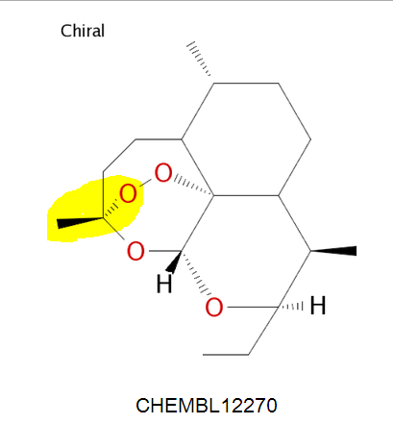
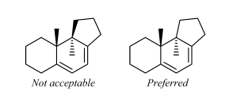
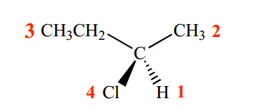
“Stereo types of the opposite bonds mismatch” -15%
http://www.iupac.org/publications/pac/2006/pdf/7810x1897.pdf

Slide 19
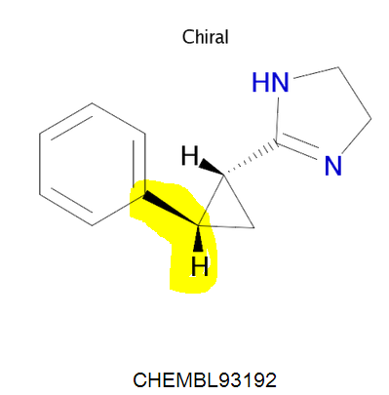
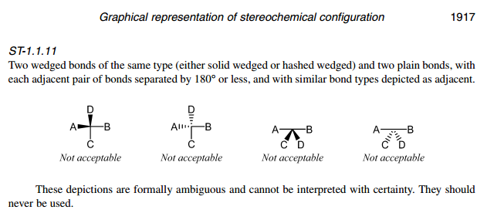
“Stereo types of non-opposite bonds match” – 2%

Slide 20
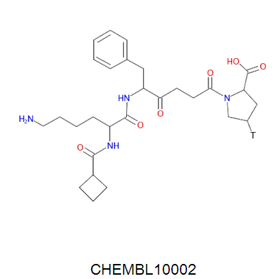
“atom not recognized” – 3% isotopes
Should be atom from periodic table
In molfile:
No mass difference in atom line
No “M ISO” in connection table

Slide 21
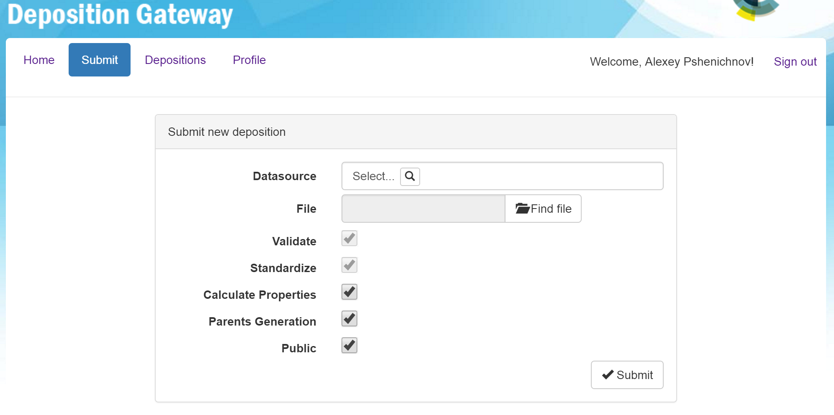
CVSP – submit file

Slide 22
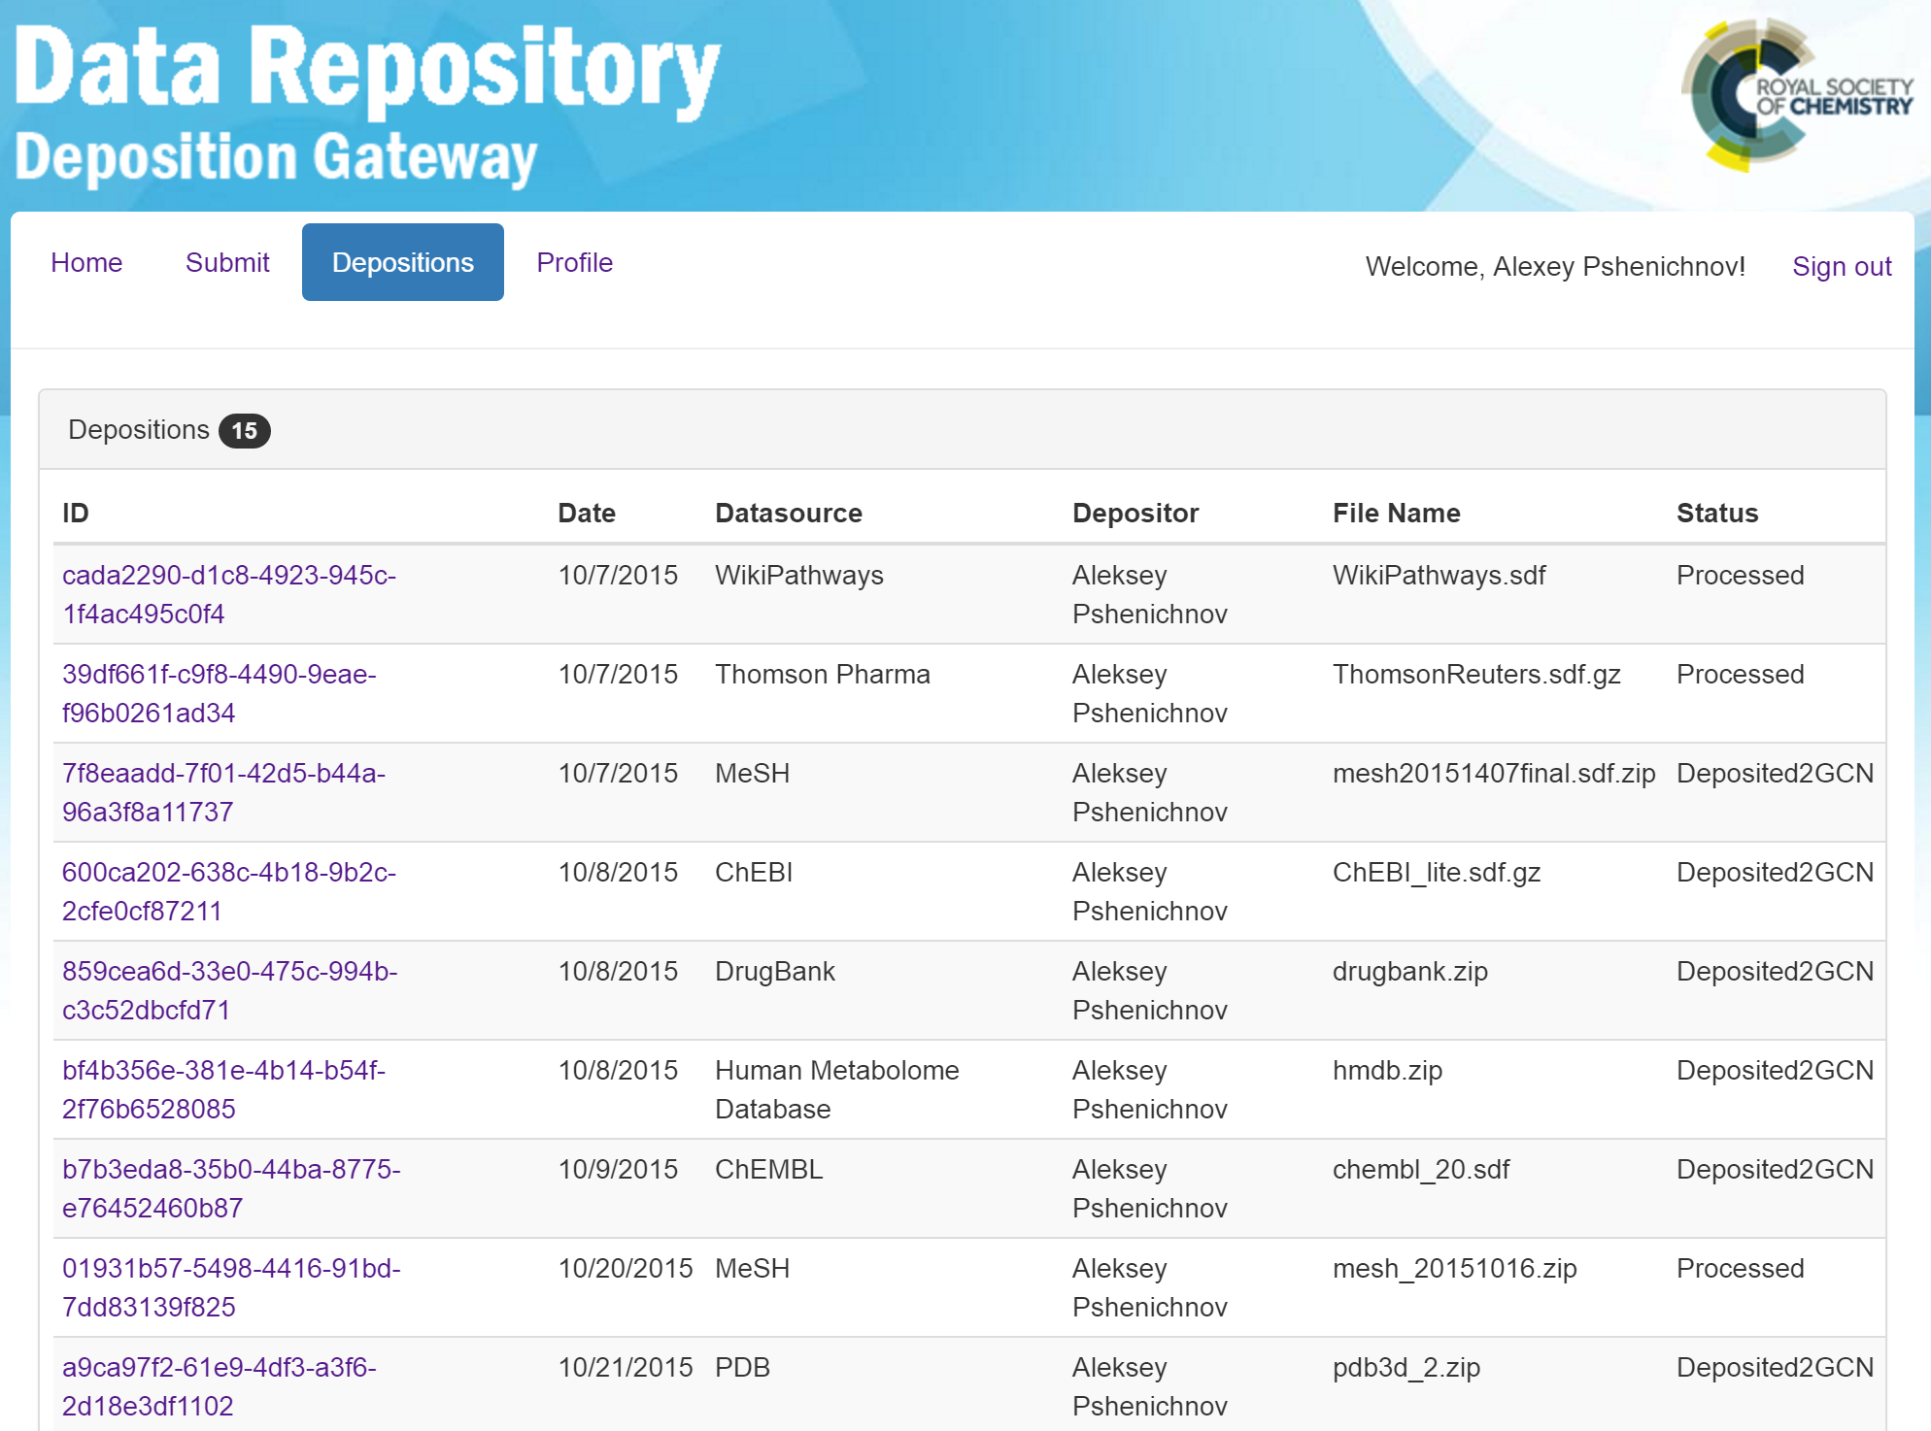
CVSP – submissions list

Slide 23
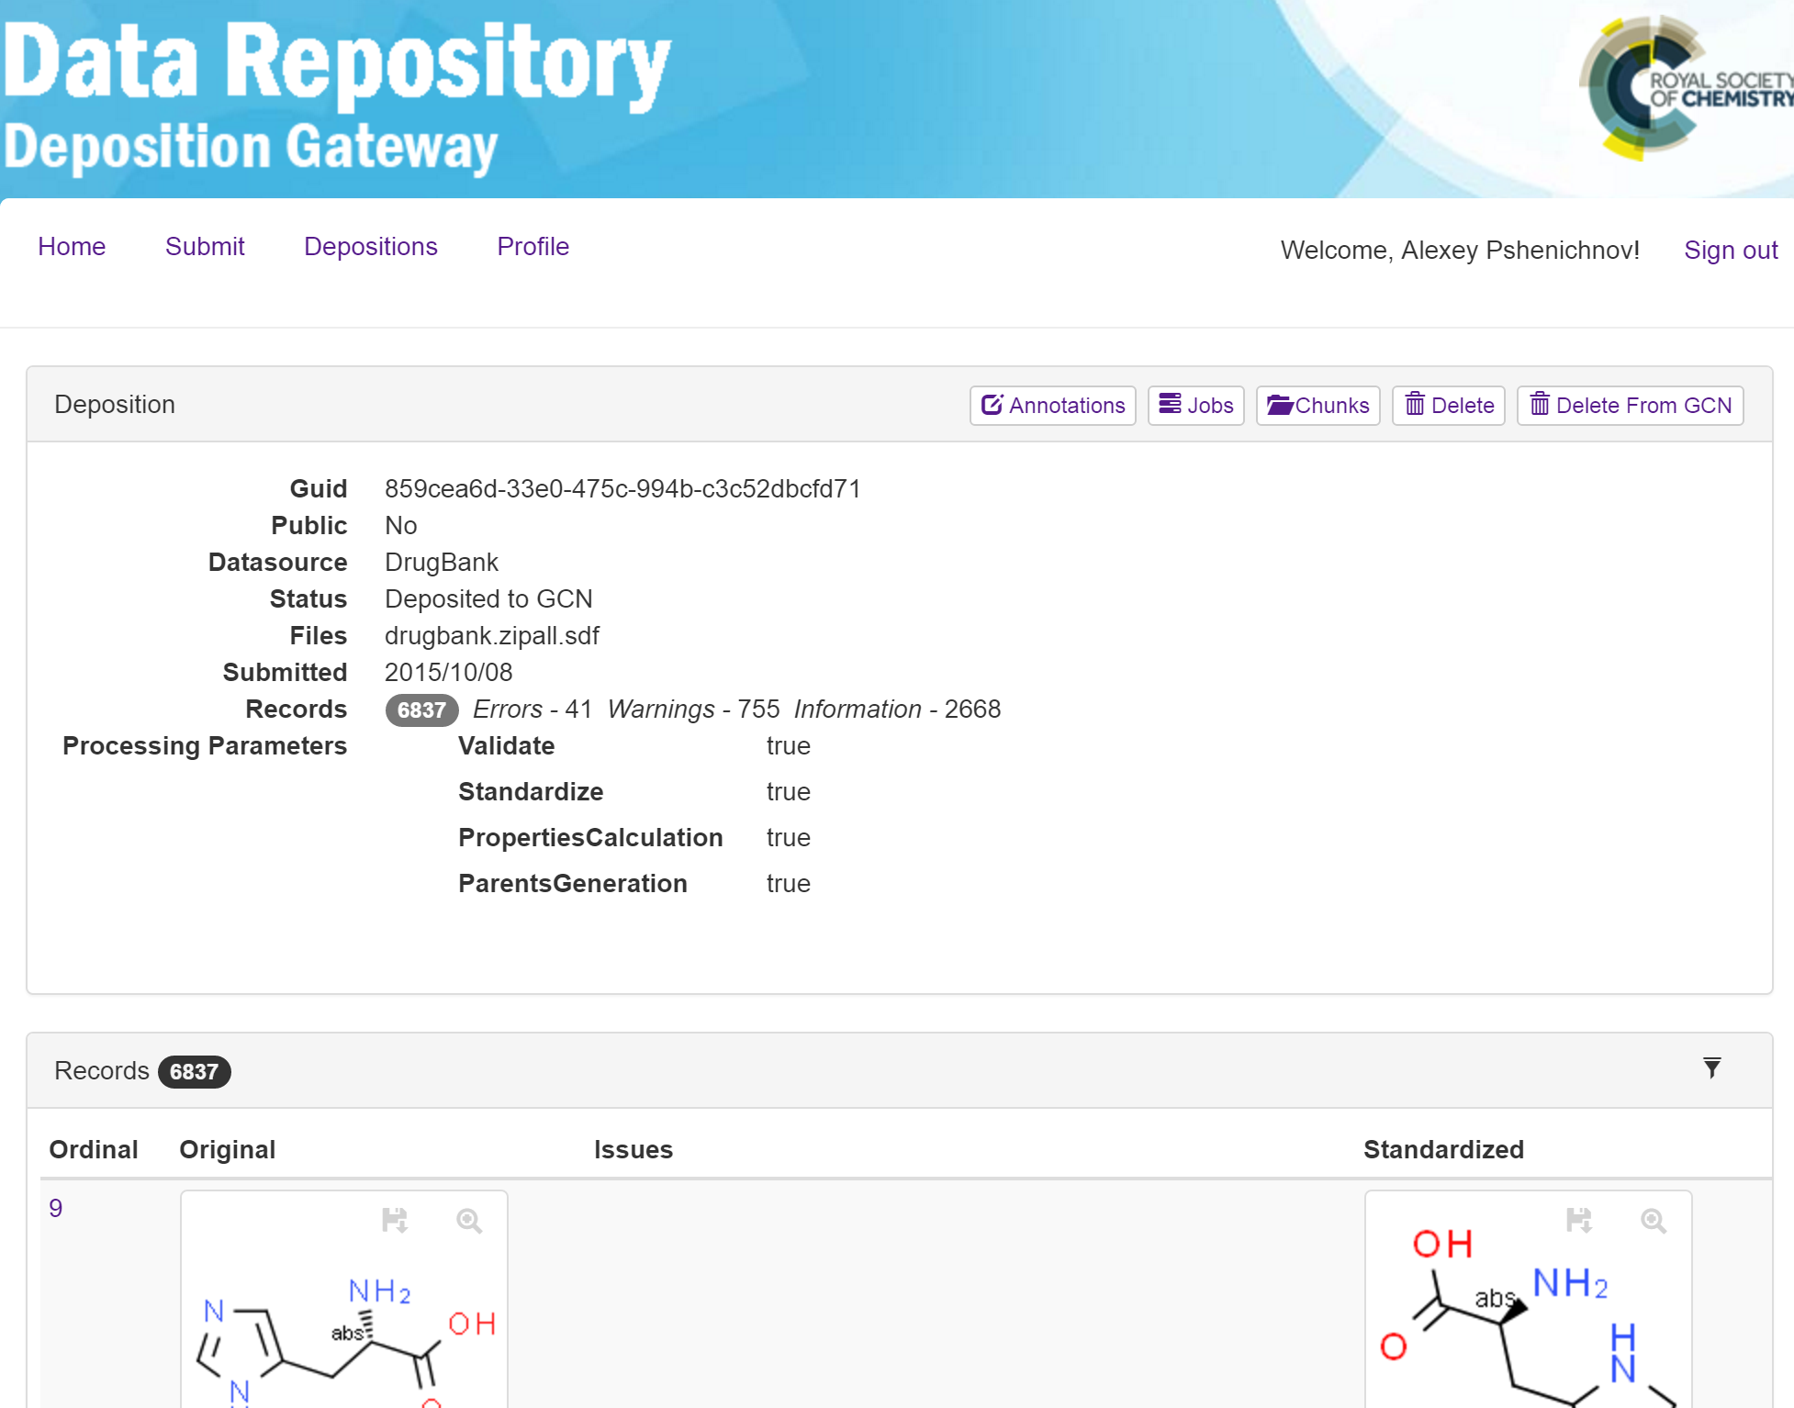
CVSP – submission details

Slide 24
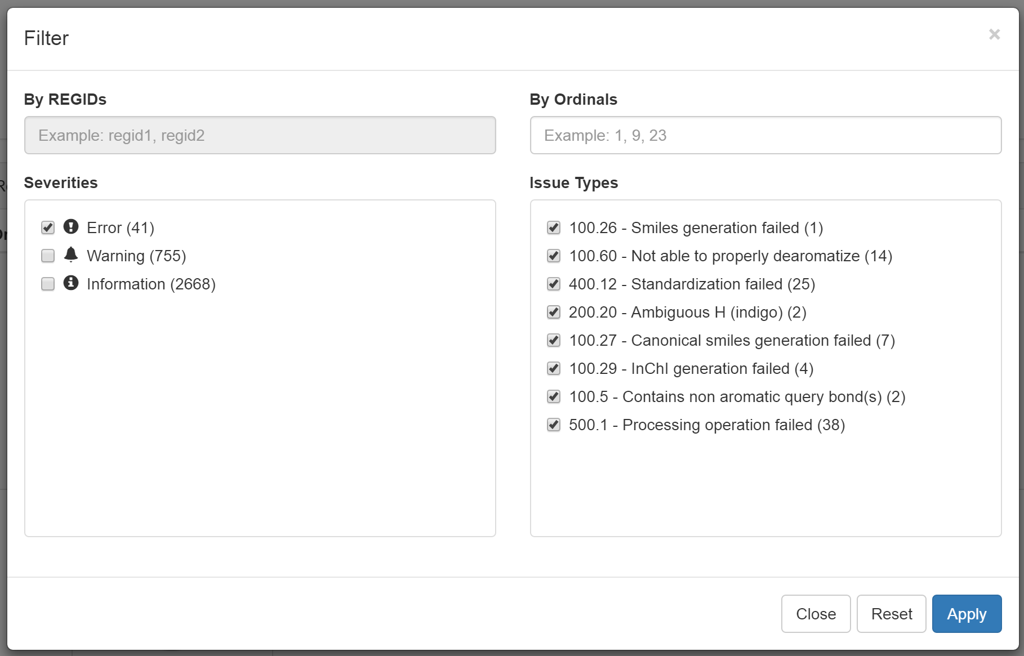
CVSP - filtering

Slide 25
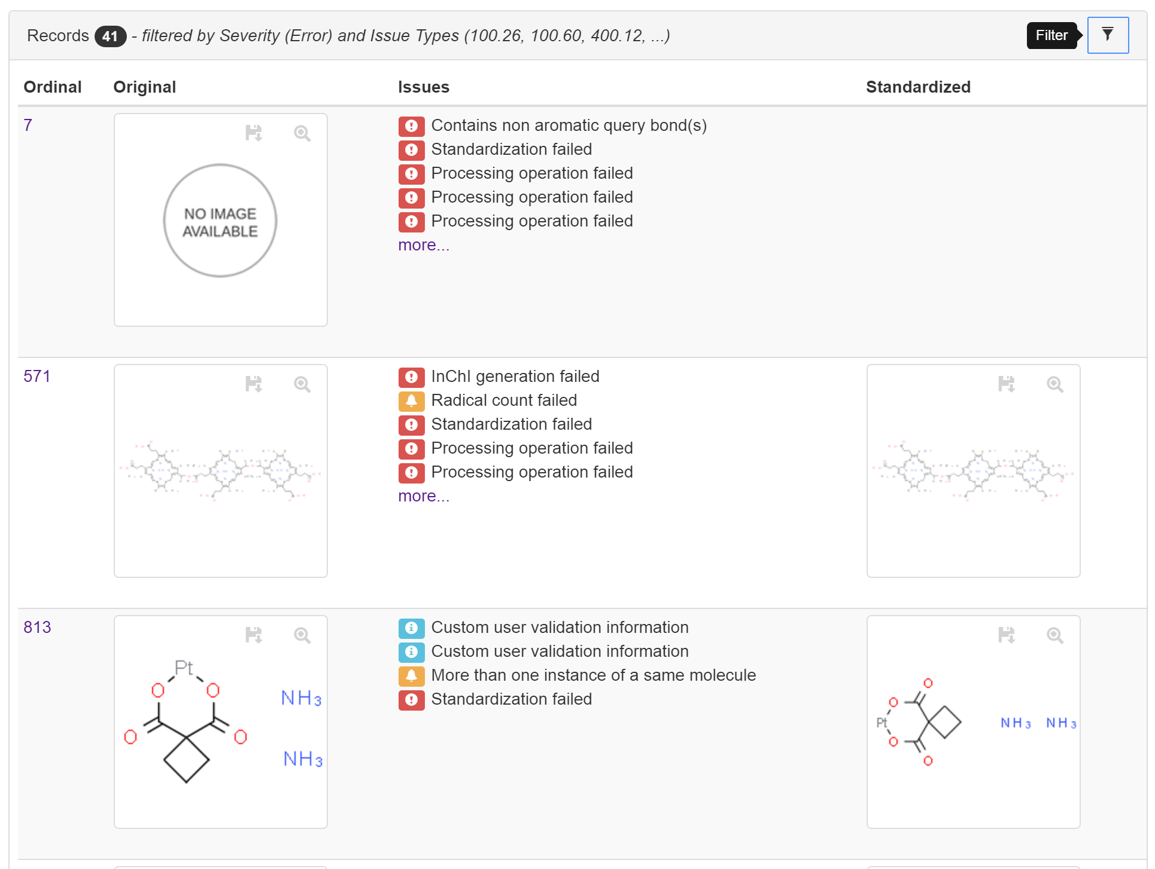
CVSP – issues review

Slide 26
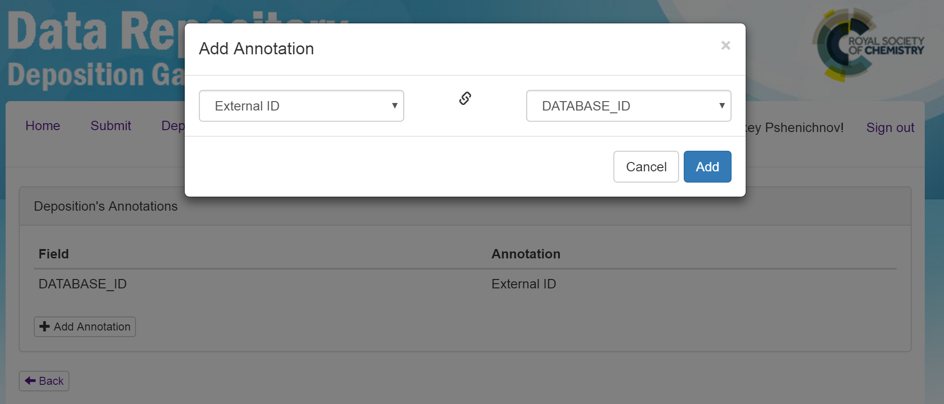
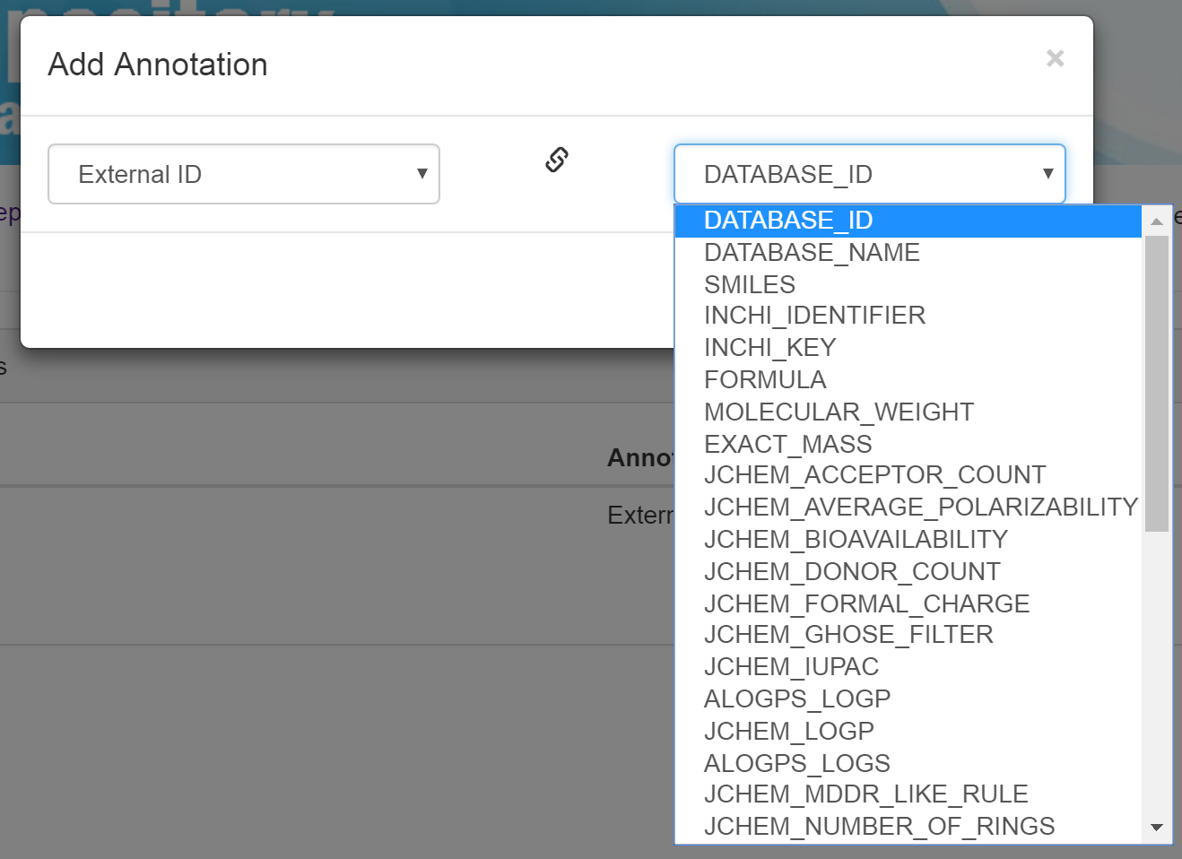
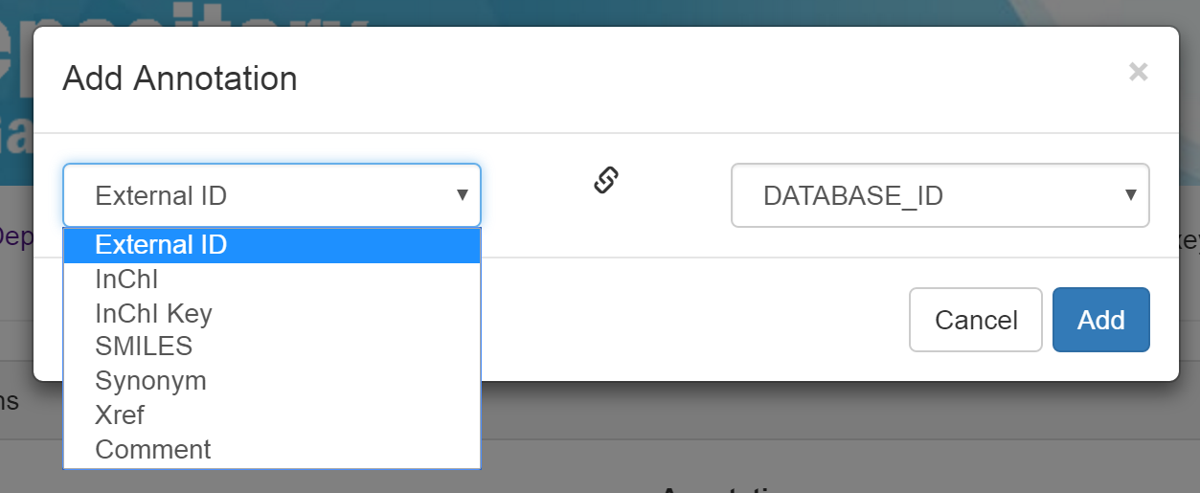
CVSP - mapping

Slide 27
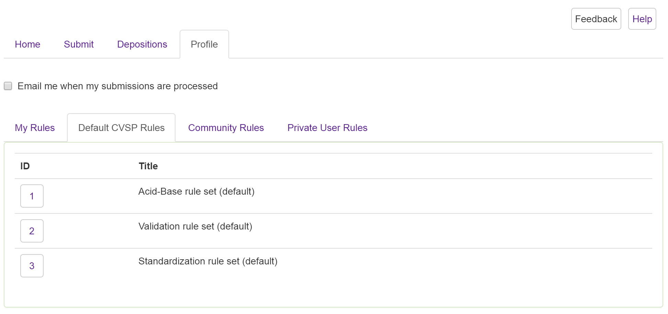
CVSP – default rules

Slide 28
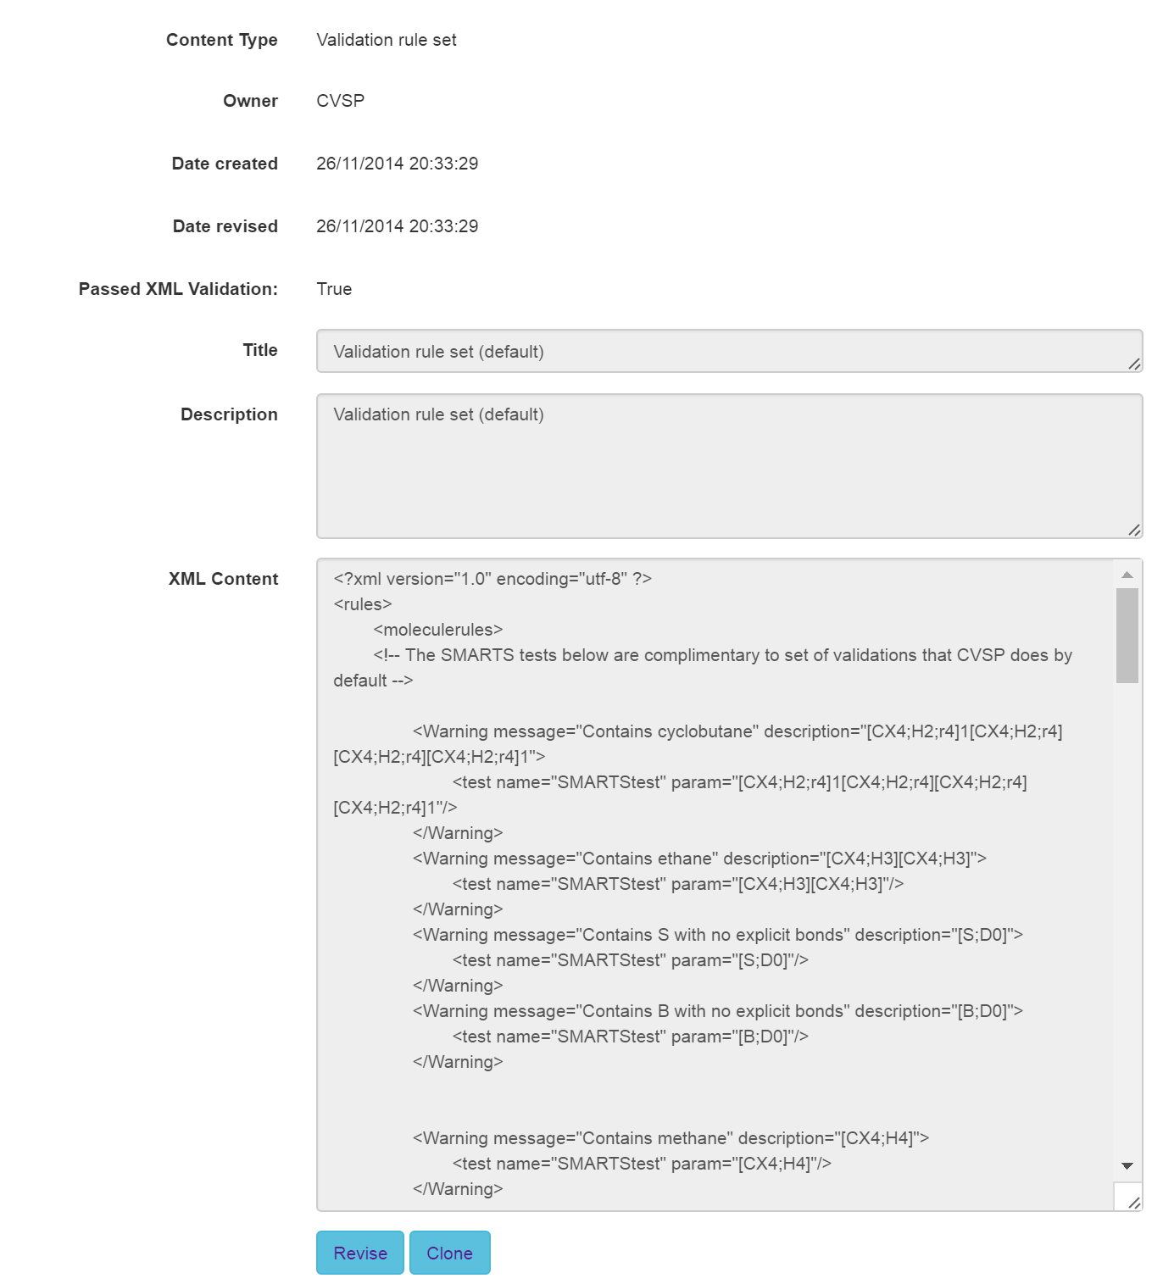
CVSP - rules

Slide 29
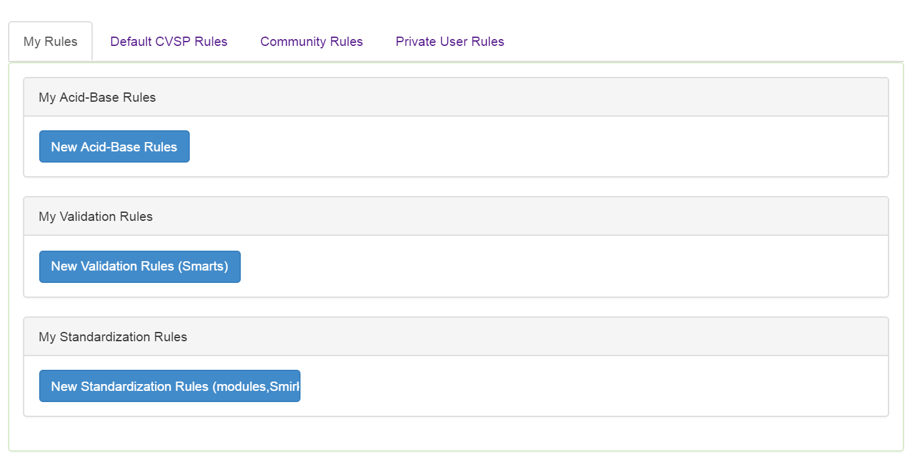
CVSP – custom rules

Slide 30
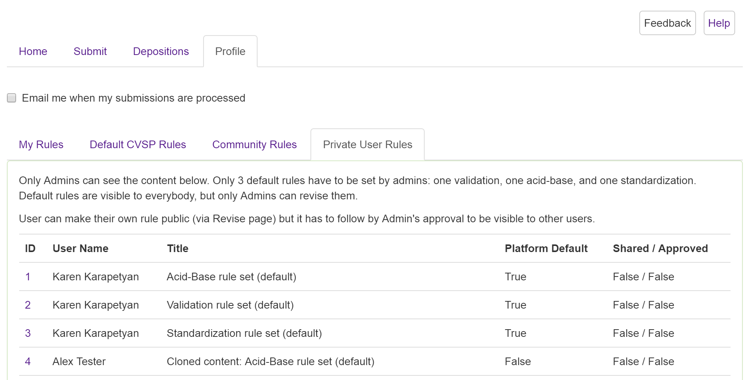
CVSP – rules

Slide 31
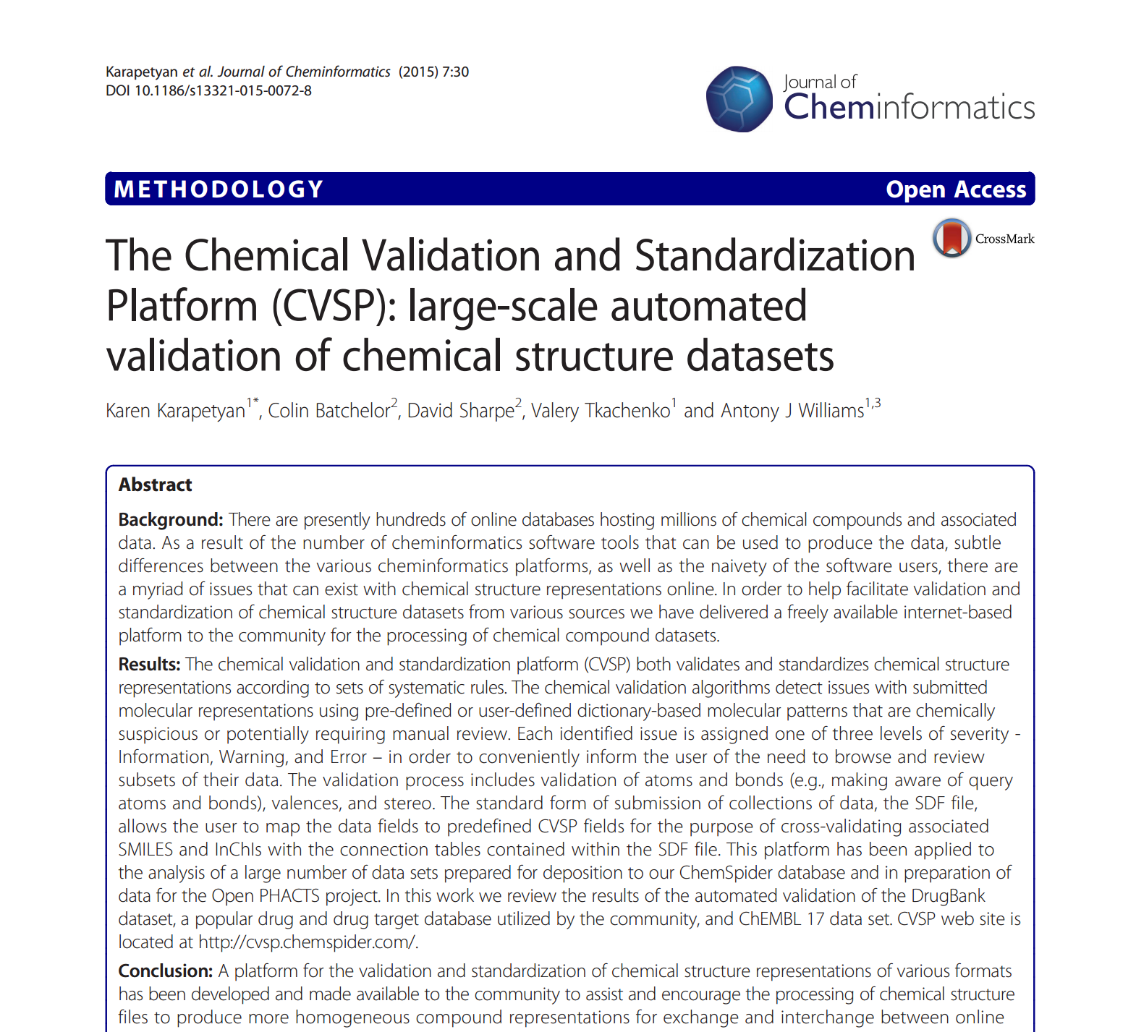

Slide 32
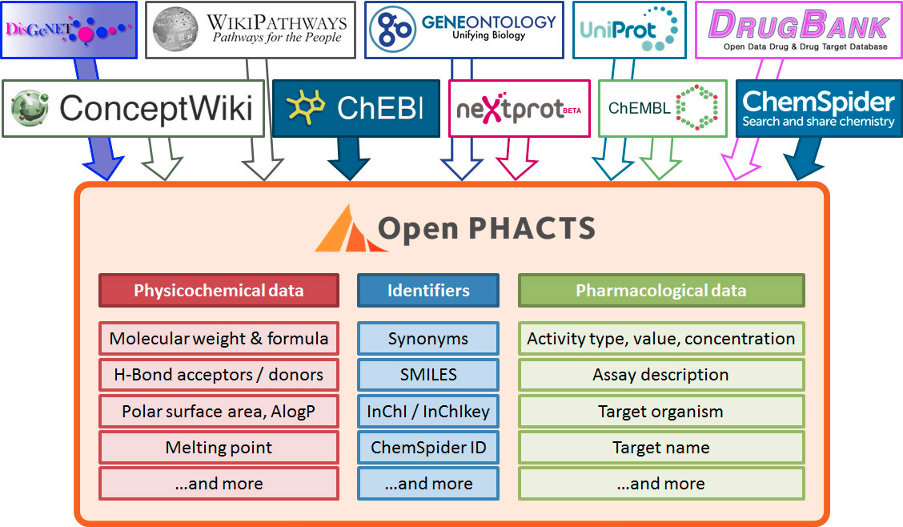
Notes:
Open PHACTS was developed to support the key questions of drug discovery
Business questions have been at the heart of Open PHACTS and have driven the development of the platform
Mx/psa, how calculated who did it?
Mash up. With your data too,
- top layer join together but need them all
commercial
Data provided by many publishers
Originally in many formats: relational, SD files and RDF
Worked closely with publishers
Data licensing was a major issue
Over 5 billion triples – 14 datasets & growing
Hosted on beefy hardware; data in memory (aim)
Extensive memcaching
Pose complex queries to extract data

Slide 33
What exactly CRS provides?
Chemistry processing
Validation
Standardization
Properties generation
Properties retrieval
Export
RDF
SDF
API
Domain-specific searches
Chemical visualization
Properties
Conversions

Slide 34
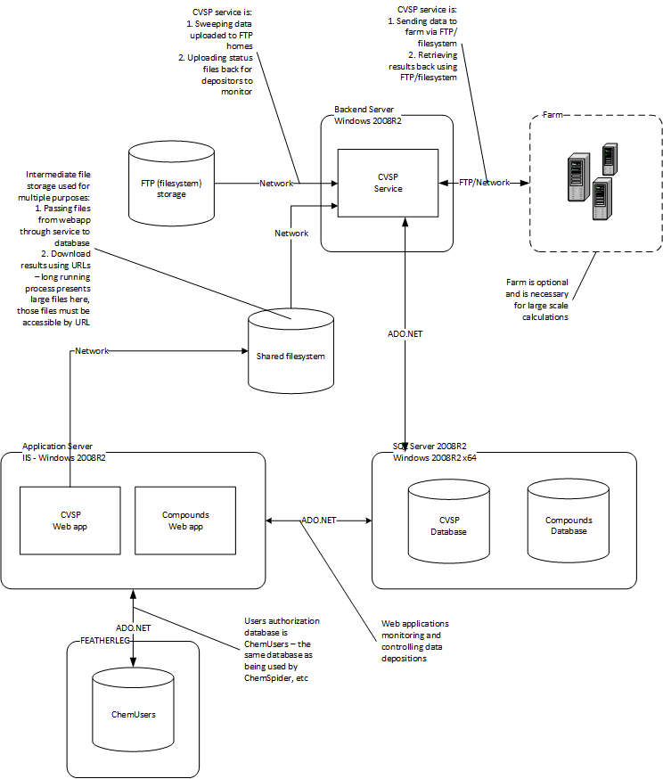

Slide 35
Subsystems
CVSP (frontend, backend, database)
Compounds (frontend, database)
OpenPHACTS API (frontend, database)
Datasources registry (frontend, database)
Processing farm (optional)

Slide 36
Virtual Machines
OPS_FRONT (all websites and API)
OPS_BACK (all heavy-lifting)
OPS_DB (databases)
VMs are VMware images
Can be converted to other hypervisors

Slide 37

Thank you
Email: tkachenkov@rsc.org
Slides: http://www.slideshare.net/valerytkachenko16
Notes:
37

